Slide 1
Welkom
Idee-doos-moment
Gent - 20 juni 2022

Slide 2
International Retail Innovation Challenge
Idee-doos-moment
Gent - 20 juni 2022
Wanneer IP en COIL mergen tot BIP
Patricia Cools
Thomas More

Slide 3
Lange mobiliteiten
Korte mobiliteiten
Summerschool Weiden
Summerschool Thomas More
BIP Heidelberg
IW Heidelberg
IW Lier
Businet Student conference
IW Antwerpen
IW Zweibrücken
BIP Budapest
IW Valencia
BIP Helsinki
IW Madrid
…

Slide 4
Short Term Mobility
International Week
(IP)
Blended Intensive Programme

Slide 5
International Retail Innovation Challenge

Slide 6
+100 studenten = +15 teams
6 coaches
1 commissioning partner
1 challenge

Slide 7
Ideation & Concept Creation
Week 46
Presenting your Idea
Weeks 49 & 50
Final 11th Dec
Kick-off
Week 43
Identifying the Problem
Week 44
Clarifying the Problem
Week 45
Concept Validation
Week 47
Pitching Solution
Week 48
Team work
Coaching sessions (pré-assignment, kick-off, four workshops, final)

Slide 8
Short Term Mobility - International Weeks (IP)

Slide 9
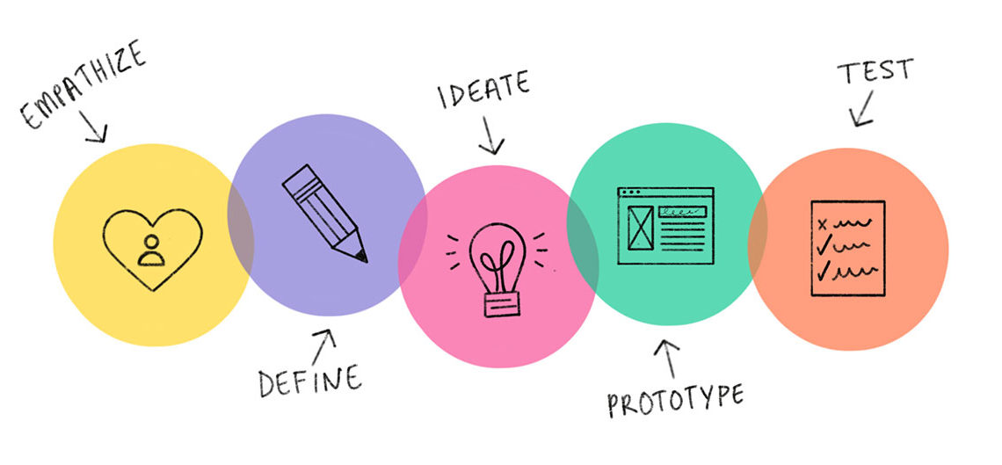
Short Term Mobility - International Weeks (IP)

Slide 10
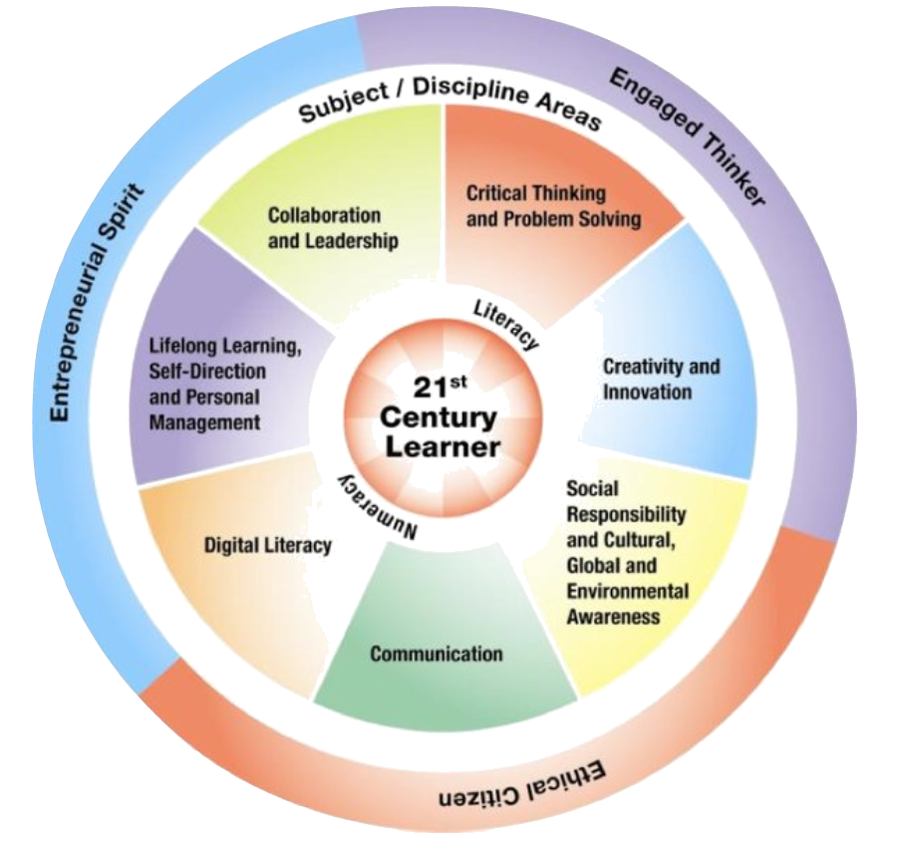
Short Term Mobility - International Weeks (IP)
Blended Intensive Programme

Slide 11
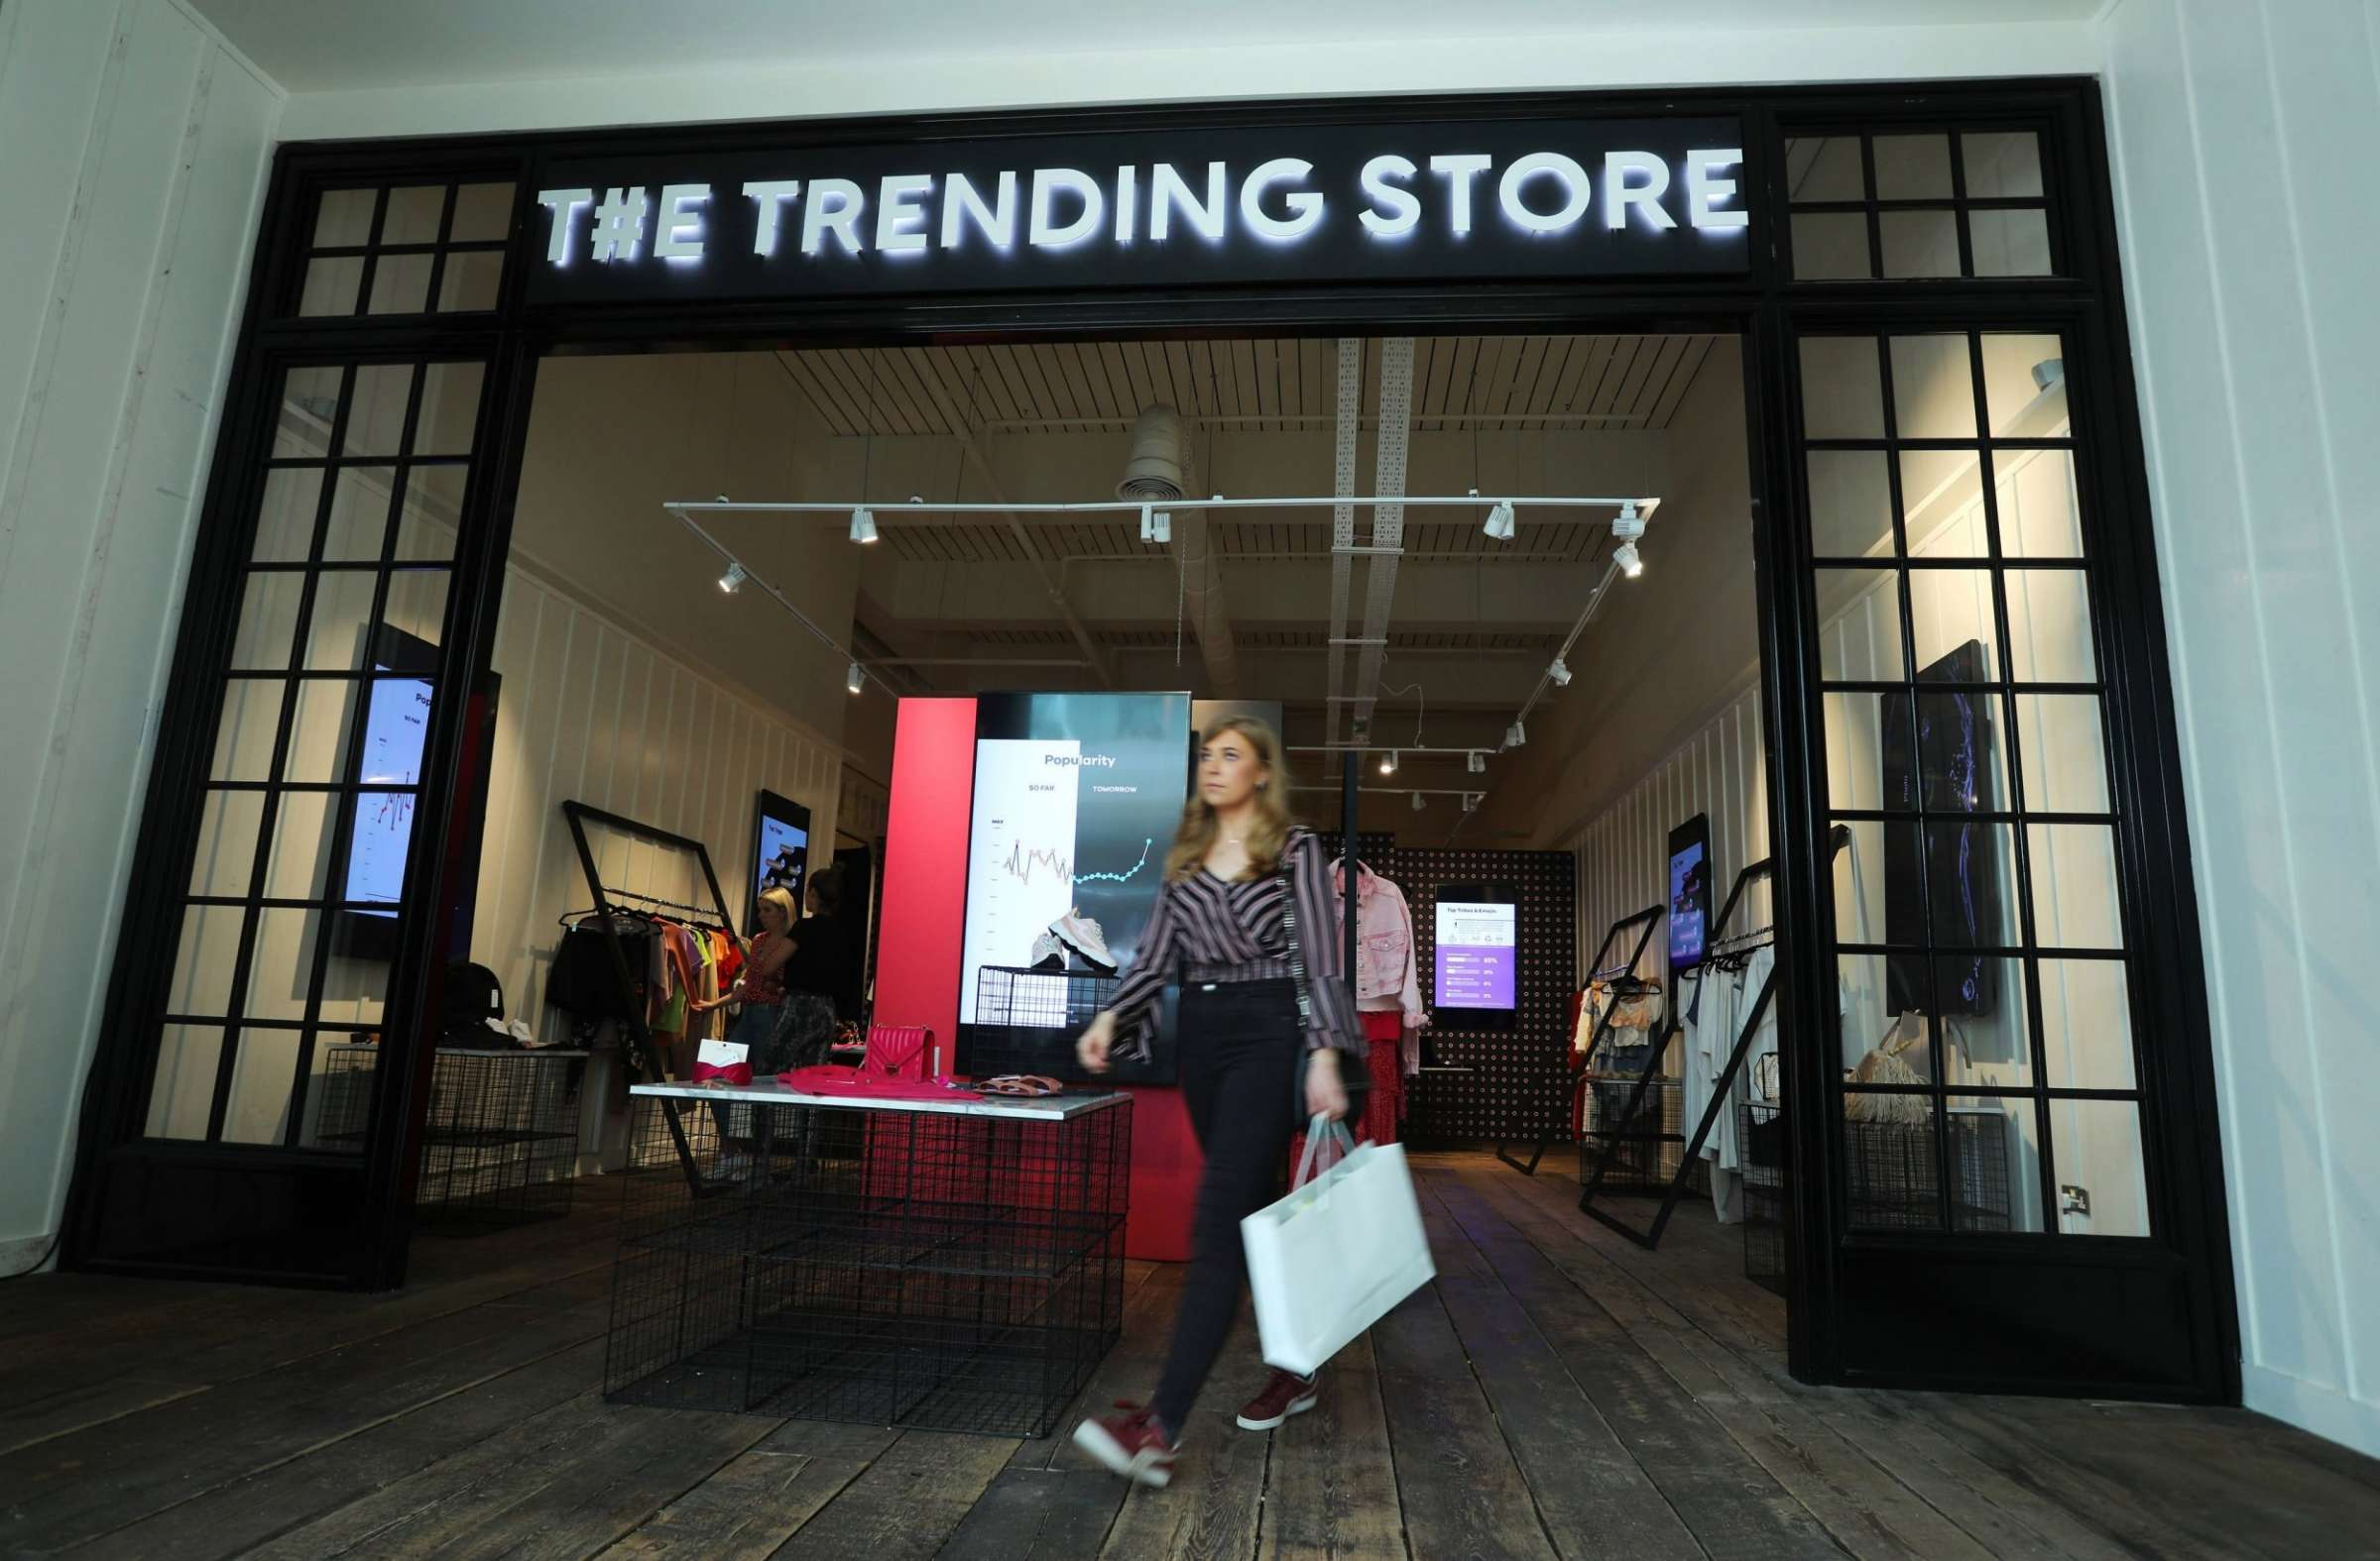
21-25 February
Antwerp

