Slide 1







Co-funded by Belgian authorities

Slide 2
Vision Statement of the Belgian AI Factory Antenna
To build and stimulate a vibrant and sustainable AI ecosystem
on strong ethical and human-centric principles,
contributing to European sovereignty,
by empowering enterprises (with a focus on SMEs and startups),
public administrations, and research organisations through
enhanced access to AI-optimised computing capabilities,
underpinning services for the training and development of general-purpose, large-scale AI models, and for the development, testing and validation of emerging AI applications, and
the development of an AI talent pool.
Co-funded by Belgian authorities

Slide 3
AI Factories and AI Factory Antennas
AI Factories | AI Factory Antennas
Dynamic ecosystems
around AI-optimized supercomputers | complementing existing AI Factories without requiring significant investment in AI-optimized supercomputers
offering computing resources | offering access to computing resources across Europe
offering support services and access to data
to the European industry and scientific users and public services for the development of large AI models
to take advantage of AI technology capabilities in the European Union, and for the development of skills and knowledge in the domain of AI.

Slide 4
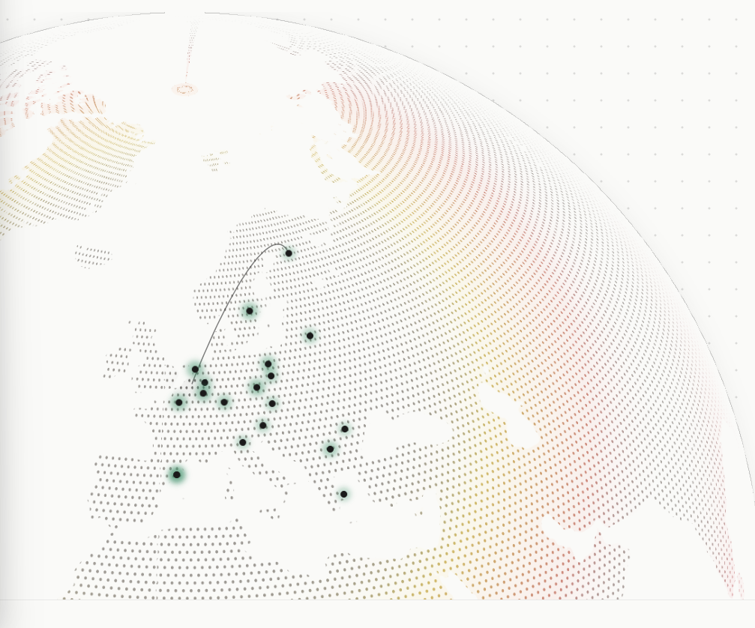


The Belgian AI Factory Antenna is your entry point into a network of AI Factories and Antennas
facilitating access to trustworthy AI compute, data and expertise.
Co-funded by Belgian authorities

Slide 5
Belgian AI Factory Antenna - Domains
Focus Domains:
Defense and Security
Health, Biotech & Life Sciences
Manufacturing, Robotics and Process Control
Space and Aeronautics
Digital transformation of Public Services
Other Domains:
Agri-Food, Environment and Climate, Mobility, Transport and Logistics, Science and Research, Media, Culture and Entertainment, Digital Services, Construction, and Cross-cutting and emerging technologies

Slide 6
Belgian AI Factory Antenna
Belgium’s gateway to European AI infrastructure
23 | Partners | 4 | Ecosystems | 2 | AI Factories
 | Consortium |  | Ecosystems & governments Flanders Wallonia Brussels-Capital Region Federal |  | LUMI(AI), Finland JAIF (JUPITER AI Factory), Germany
10 | M€
 | Budget 5M€ Funding EuroHPC JU 5M€ Member State
3 | Year | 3 | Customer groups | 1 | -stop shop
 | project |  | Companies (esp. SMEs, Start-ups) Research Organisations Public Administrations |  | 1 service catalog
Co-funded by Belgian authorities

Slide 7
Belgian AI Factory Antenna Consortium
4 Entities – 23 partners
Federal level | Flanders | Wallonia | Brussels-Capital Region
Research centres
Sciensano | IMEC | Cenaero | Sirris
SCK CEN | Sirris | CETIC
 | VIB | Multitel
Universities
 | KU Leuven | UCLouvain | ULB
 | UAntwerpen | ULB | VUB
 | UGent | ULiège
 | UHasselt | UMons
 | VUB | UNamur
Public organisations
BELSPO |  | Agence Du Numérique
Belnet
FPS BOSA
FPS Economy

Slide 8
The launch events of the BE-AIFA
April | May | June | July | August | September | October | November | …
START
BE-AIFA launched with starter set of services
BE-AIFA operational with full set of services
Kick-off Consortium Meeting
BE-AIFA Introduction event
(1 June)
BE-AIFA Launch event
(16 September)
First review by EuroHPC JU

Slide 9
Contact
Website: https://www.be-aifa.eu/nl/
Email: matthias.strobbe@ugent.be
Co-funded by Belgian authorities

